Slide 1



Startup Success Prediction
Team Members: Dhyey Patel
Jignesh Panchal
Pratham Patel
Kunal Patil
Guide: Jay Rathod
Disclaimer: The content is curated for educational purposes only.

Slide 2
OUTLINE
Abstract
Problem Statement
Aims, Objective & Proposed System/Solution
System Design/Architecture
System Development Approach (Technology Used)
Algorithm & Deployment
Conclusion
Future Scope
References
Video of the Project
Notes:
These are the list of chapters that we are going to cover in these foundation codes. Those are chapter one what are AI and ML? chapter 2 applied Python programming in AI, and chapter 3 is exploratory data analysis for ML.

Slide 3
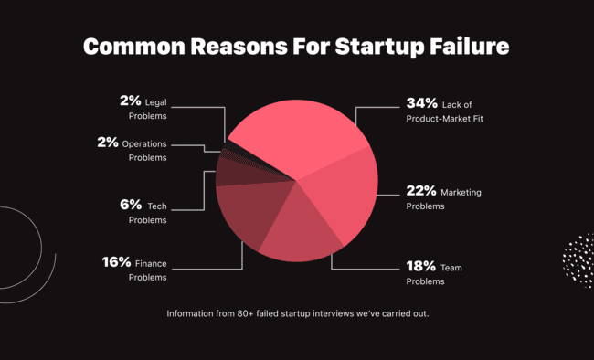
Abstract
This project, titled "Startup Success Prediction," leverages AI and machine learning to predict the success of startups. Utilizing a comprehensive dataset with various parameters such as location, funding rounds, and current status, the model identifies key factors influencing startup outcomes. By implementing advanced predictive algorithms, the project aims to provide insights into the likelihood of success or failure for new ventures. The analysis covers funding distributions, geographical impact, and status trends, offering valuable information for investors and entrepreneurs. This high-level predictive model serves as a powerful tool for making data-driven decisions, enhancing the understanding of startup dynamics, and fostering successful business strategies. The integration of AI and machine learning in this context demonstrates the potential of technology to revolutionize the startup ecosystem.

Slide 4
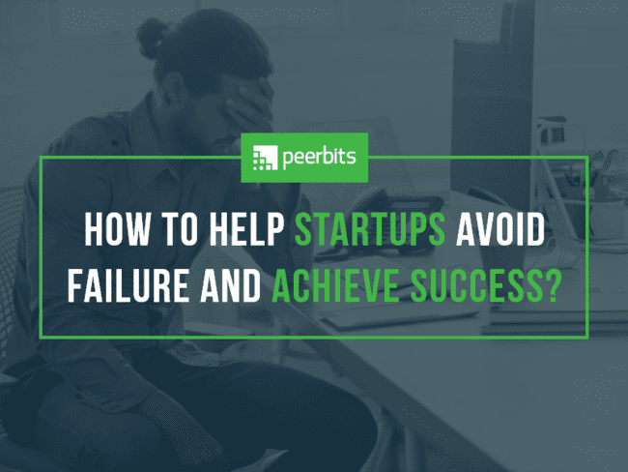
Problem Statement
High uncertainty and risk associated with the success of startups.
Difficulty in predicting success due to various unpredictable factors.
Need for a data-driven approach to assess and understand factors contributing to startup success or failure.

Slide 5
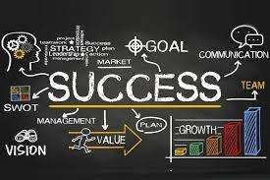
Aim and Objective
Primary Objectives
Develop an AI/ML model to predict startup success.
Analyze factors like location, funding, and status.
Provide insights on success likelihood.
Goals
Achieve high predictive accuracy.
Offer detailed insights on funding, geography, and trends.
Provide actionable information for stakeholders.

Slide 6
Proposed Solution
Predictive Model Development: Leverage AI and machine learning to create a model that predicts startup success.
Comprehensive Dataset Analysis: Utilize a dataset with parameters such as location, funding rounds, and current status to identify key factors influencing outcomes.
Advanced Algorithms: Implement advanced predictive algorithms to analyze the data and provide insights.
Key Factors Identification: Identify and highlight the most significant factors that impact startup success.
Insight Generation: Provide actionable insights and trends for investors and entrepreneurs, covering funding distributions, geographical impact, and status trends.
Decision Support: Enhance decision-making capabilities for stakeholders by offering a high-level predictive model.
Technology Integration: Demonstrate the potential of AI and machine learning to revolutionize the startup ecosystem through data-driven analysis.

Slide 7
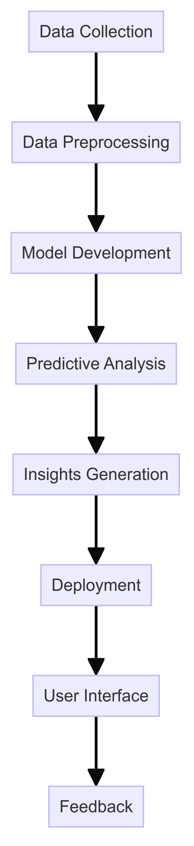
System Architecture
Data Collection
Source: Comprehensive dataset including parameters like location, funding rounds, and current status.
Tools: APIs, web scraping, and databases.
Data Preprocessing
Steps: Cleaning, normalization, and feature engineering.
Tools: Python libraries (Pandas, NumPy).
Model Development
Techniques: Machine learning and AI algorithms.
Tools: Scikit-learn, TensorFlow, Keras.
Process: Training, validation, and testing.
Predictive Analysis
Approach: Implement advanced predictive algorithms.
Output: Probability of success, key influencing factors.
Insights Generation
Analysis: Funding distributions, geographical impact, and status trends.
Visualization: Charts, graphs, and reports.
Tools: Matplotlib, Seaborn, Tableau.
Deployment
Platform: Cloud services ,(Azure)
Accessibility: Web app, API endpoints for stakeholders.
User Interface
Design: Interactive dashboard for investors and entrepreneurs.
Tools: React, Flask/Django for web app development.
Feedback
Data Collection: Continuous data updates.
Model Improvement: Retraining with new data.

Slide 8
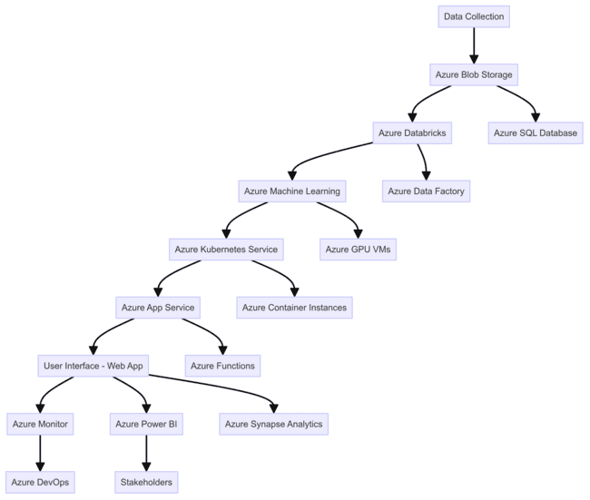
System Deployment Approach
Azure Blob Storage: Store raw and processed data.
Azure SQL Database: Structured storage for relational data.
Model Development and Training
Azure Machine Learning: Train and deploy machine learning models. Azure Databricks: Data processing and feature engineering.
Model Deployment
Azure Kubernetes Service (AKS): Deploy predictive models as scalable services.
Azure Functions: Serverless compute for executing model inferences.
Insights and Visualization
Power BI: Create interactive dashboards and reports for stakeholders.
Azure Synapse Analytics: Data integration and advanced analytics.
Web Application and API
Azure App Service: Host the web application for user access.
Azure API Management: Manage API endpoints for model predictions.
Monitoring and Feedback
Azure Monitor: Track performance and usage metrics.
Azure Log Analytics: Collect and analyze log data for continuous improvement.

Slide 9
Algorithm & Deployment
Data Preprocessing
Clean, normalize, and engineer features from the dataset.
Model Training
Use machine learning algorithms to train the predictive model.
Techniques: Random Forest, Gradient Boosting, Neural Networks.
Model Evaluation
Validate model accuracy with test data.
Metrics: Accuracy, Precision, Recall, F1 Score.
Deployment
Deploy the trained model on Azure Kubernetes Service (AKS).
Provide API endpoints for real-time predictions.

Slide 10
Conclusion
Effective Prediction: Successfully developed an AI/ML model that accurately predicts startup success.
Comprehensive Insights: Analyzed key factors like location, funding rounds, and current status to provide detailed insights.
Data-Driven Decisions: Enabled investors and entrepreneurs to make informed, data-driven decisions.
Strategic Planning: Improved strategic planning and resource allocation for startups.
Impact on Ecosystem: Demonstrated the potential of AI and machine learning to revolutionize the startup ecosystem by offering valuable predictions and enhancing the understanding of startup dynamics.
Future Potential: Highlighted the capability of advanced predictive algorithms to foster successful business strategies and reduce the risk of failure in new ventures.

Slide 11
Future Scope
Real-Time Data Integration: Incorporate real-time data for more accurate predictions.
Model Enhancement: Continuously improve the model with new data and advanced algorithms.
Expanded Data Sources: Include more diverse and global data sources.
User Interface Upgrades: Enhance the dashboard for better user experience.
Scalability: Optimize for handling larger datasets and more users.

Slide 12
Reference
https://azure.microsoft.com/en-in/products/machine-learning
https://www.tensorflow.org/
https://scikit-learn.org/stable/
https://www.kaggle.com/datasets/manishkc06/startup-success-prediction
Notes:
Reference
These are the references for this session.
12

Slide 13
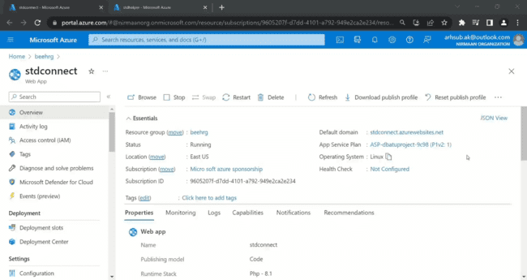

Slide 14
Thank you!
Notes:
thank you very much for joining this PPT, keep learning.
14

